Slide 1


Summer Training Project
LIFESTYLE STORE
Shivansh Rastogi
(02915003116)
Submitted by :
B.Tech (IT), 7th Semester
1

Slide 2

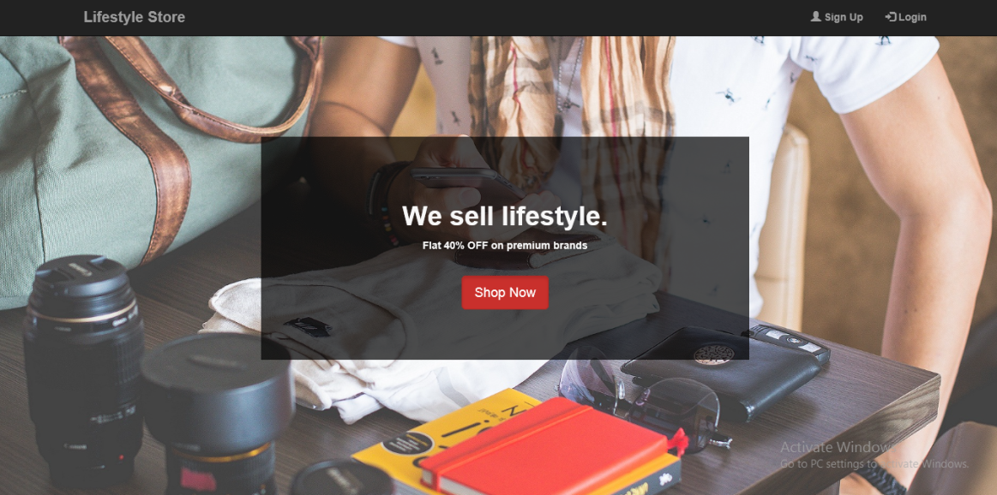
Lifestyle Store
Online stores like lifestyle store are websites that sell products online and are one of the most visible segments of e-commerce. This space includes Amazon, flipkart all of which have significant online presences. One feature of online stores is that they allow companies to build a large audience with less investment than a typical brick-and-mortar store.

Slide 3







Technology used :

Slide 4

Objective of Training
Learn HTML & CSS to build structure of web pages and to style them
Learn to use Bootstrap to develop responsive mobile web pages
Learn to write SQL queries to create, manage, and store information in the database
Learn PHP to perform operations on database and to build functional logic

Slide 5


What is html 5?
Hypertext Mark-up Language revision 5 (HTML5) is markup language for the structure and presentation of World Wide Web contents. It is cooperation between the World Wide Web Consortium (W3C) and the Web Hypertext Application Technology Working Group (WHATWG).
ORGANISATIONS :
1. Web Hypertext Application Technology Working Group (WHATWG) created the HTML5 specification and is in charge of the HTML5 development that provides open collaboration of browser vendors and other involved parties.
2. World Wide Web Consortium (W3C) is in charge with delivering the HTML5 specification.
3. Internet Engineering Task Force (IETF) is in charge of the development of HTML5 Web-Socket API.

Slide 6
Features of html5
New Semantic Elements − These are like <header>, <footer> etc.
Forms 2.0 − New available types of form controls include dates and times, email, url, search, number, range, tel and color.
Canvas − This supports a two-dimensional drawing surface that you can program with JavaScript.
Audio & Video − You can embed audio or video on your webpages without resorting to third-party plugins.
Geo-location − Now visitors can choose to share their physical location with your web application.
Micro-data − This lets you create your own vocabularies beyond HTML5 and extend your web pages with custom semantics.
Drag and drop − Drag and drop the items from one location to another location on the same webpage.

Slide 7

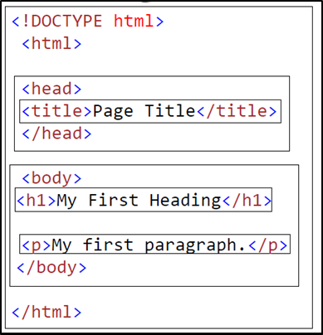
HTML5 Page Structure:
The structure of HTML page as follows:
The DOCTYPE declaration defines the document type to be HTML
The text between<html>and</html>describes an HTML document
The text between<head>and</head>provides information about the document
The text between<title>and</title>provides a title for the document
The text between<body>and</body>describes the visible page content
The text between<h1>and</h1>describes a heading
The text between<p>and</p>describes a paragraph

Slide 8

Form elements :
There are various types of form elements that are used in Html5.
Tag | Description
<form> | Defines an HTML form for user input
<input> | Defines an input control
<textarea> | Defines a multiline input control (text area)
<label> | Defines a label for an <input> element
<fieldset> | Groups related elements in a form
<legend> | Defines a caption for a <fieldset> element
<select> | Defines a drop-down list
<option> | Defines an option in a drop-down list
<button> | Defines a clickable button
<output> | Defines the result of a calculation
Table : Form elements

Slide 9

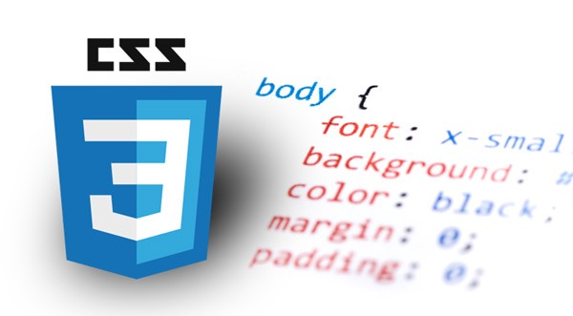
CSS (Cascading Style Sheets)
CSS stands for Cascading Style Sheets. CSS describes how HTML elements are to be displayed on screen, paper, or in other media.CSS saves a lot of work. It can control the layout of multiple web pages all at once. CSS is used to define styles for your web pages, including the design, layout and variations in display for different devices and screen sizes.
Types of CSS :
Inline : using a style attribute in HTML elements
Internal : using a<style> element in the HTML <head> section
External : using one or more external CSS files

Slide 10
TYPES OF STYLING
A. Inline Styling:
Inline styling is used to apply a unique style to a single HTML element:
Inline styling uses the style attribute.
Example: < h1 style = " color: blue ;"> This is a Blue Heading </h1>
This example changes the text color of the <h1> element to blue
B. Internal Styling
Internal styling is used to define a style for one HTML page. Internal styling is defined in the <head> section of an HTML page, within a <style> element:
Example:
<head>
<style>
p{color: green ;}
</style>
</head>
Notes:
32

Slide 11

TYPES OF STYLING
3. External Styling
An external stylesheet is used to define the style for many pages. With an external stylesheet, you can change the look of an entire website by changing one file. To use external stylesheet, add a link to it in the <head> section of the HTML page.
HTML File:
<html>
<head>
<link rel =" stylesheet "href= "styles.css">
</head>
<body>
<h1>This is a heading</h1>
<p>This is a paragraph.</p>
</body>
</html>
CSS File:
h1 { color: blue;}
p { color: green;}

Slide 12
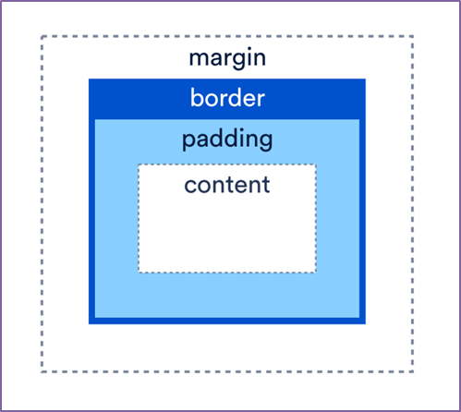
CSS Box Model
All HTML elements can be considered as boxes. In CSS, the term "box model" is used when talking about design and layout. The CSS box model is essentially a box that wraps around every HTML element. It consists of: margins, borders, padding, and the actual content. The image below illustrates the box model:
Every HTML element has a box around it, even if you cannot see it.
The CSS border property defines a visible border around an HTML element.
The CSS padding property defines padding (space) inside the border.
The CSS margin property defines a margin (space) outside the border.

Slide 13

Bootstrap
Bootstrap is a free and open-source CSS framework directed at responsive, mobile-first front-end web development. It contains CSS- and (optionally) JavaScript-based design templates for typography, forms, buttons, navigation and other interface components.
Bootstrap Components
Container
Containers are the most basic layout element in Bootstrap and are required when using our default grid system. Choose from a responsive, fixed-width container or fluid-width. While containers can be nested, most layouts do not require a nested container.
Syntax :
<div class="container">
<!-- Content here -->
</div>

Slide 14
2. Container Fluid
.container-fluid continuously resizes as you change the width of your window/browser by any amount. Use .container-fluid when you want your page to shape shift with every little difference in its viewport size. .container-fluid has the CSS property width: 100%;, so it continually readjusts at every screen width granularity.
Syntax :
<div class="container-fluid">
<!-- Content here -->
</div>
3. Jumbotron
A jumbotron indicates a big grey box for calling extra attention to some special content or information. Inside a jumbotron we can put nearly any valid HTML, including other Bootstrap elements/classes.
Syntax :
<div class="jumbotron">
< h1>Bootstrap Tutorial</h1>
<h2>Bootstrap Tutorial</h2>
<p>Bootstrap is the most popular HTML, CSS...</p>
</div>

Slide 15
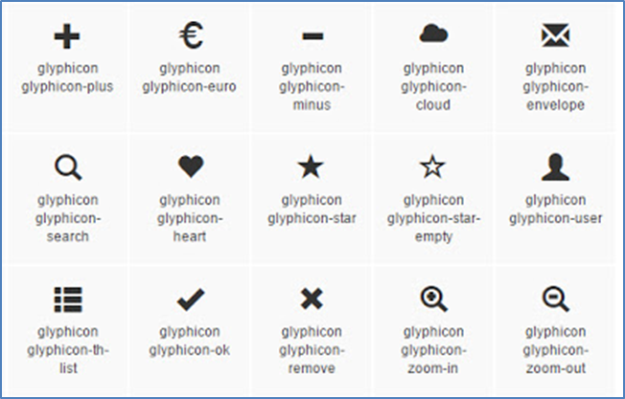
Glyphicons
Includes over 250 glyphs in font format from the Glyphicon Halflings set. Glyphicons Halflings are normally not available for free, but their creator has made them available for Bootstrap free of cost.

Slide 16

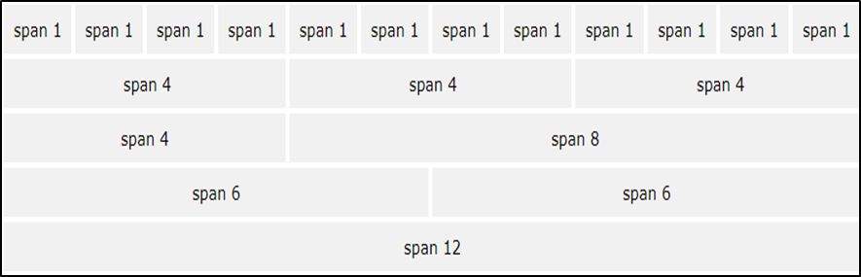
Bootstrap Grid System
Bootstrap's grid system allows up to 12 columns across the page. If you do not want to use all 12 columns individually, you can group columns together to create wider.
Bootstrap's grid system is responsive, and the columns will re-arrange depending on the screen size.
On a big screen it might look better with the content organized in three columns, but on a small screen it would be better if the content items were stacked on top of each other.

Slide 17
Bootstrap Grid System
Grid Classes:
The Bootstrap 4 grid system has five classes:
1..col- (extra small devices - screen width less than 576px)
2..col-sm- (small devices - screen width equal to or greater than 576px)
3..col-md- (medium devices - screen width equal to or greater than 768px)
4..col-lg- (large devices - screen width equal to or greater than 992px)
5. col-xl- (x-large devices - screen width equal to or greater than 1200px)
Example:
<div class="row">
<div class="col-*-*"></div>
<div class="col-*-*"></div> <div class="col-*-*"></div>
</div>

Slide 18

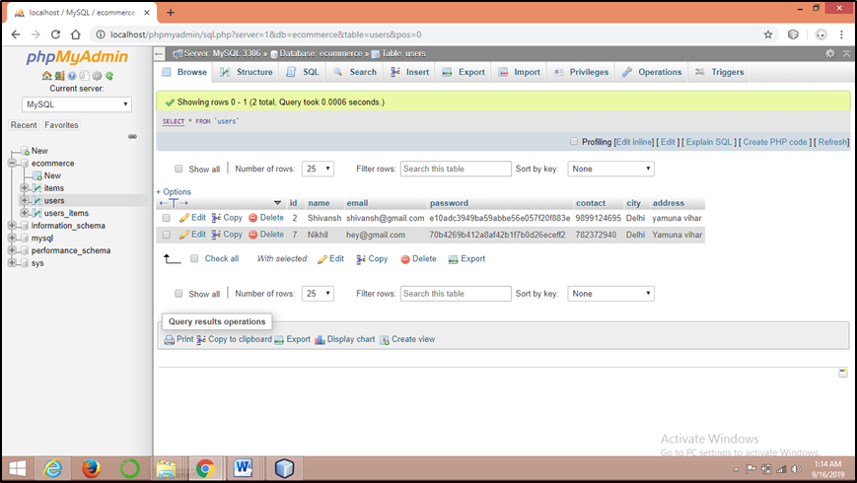
Table - Structure
Users Table

Slide 19
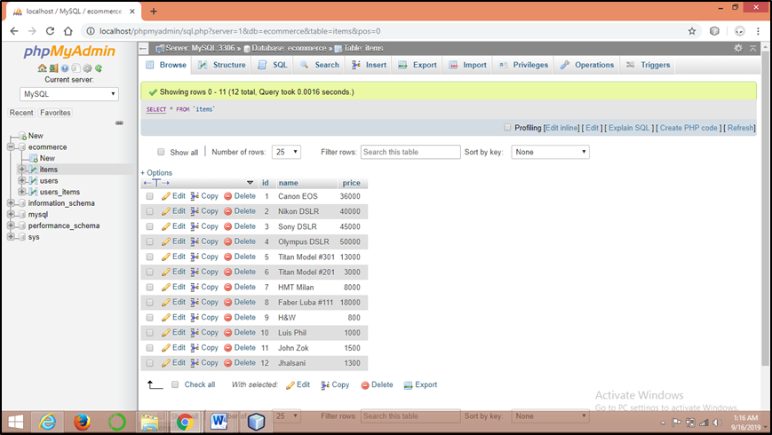
table - Structure
Items Table

Slide 20
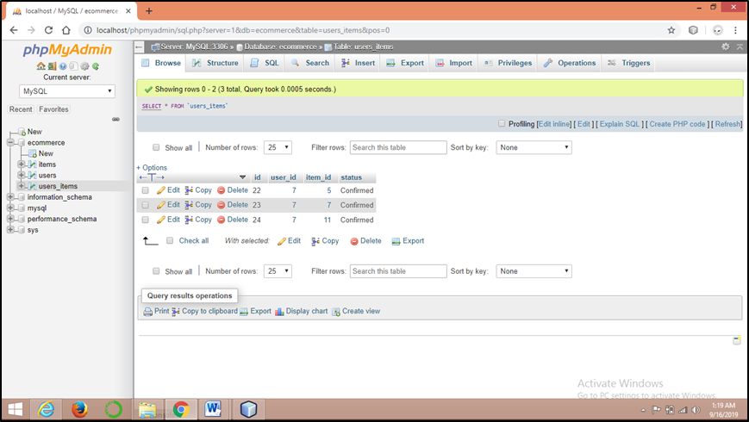
table - Structure
Users_Items Table

Slide 21
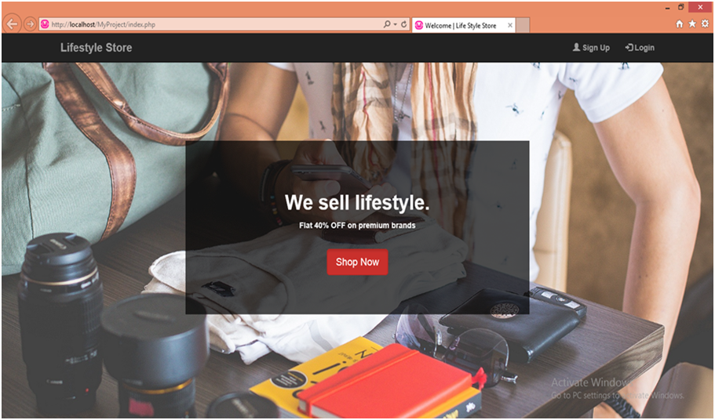
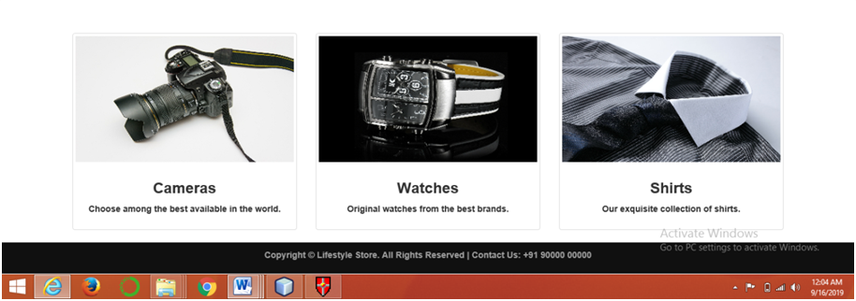
Screenshots
Homepage

Slide 22
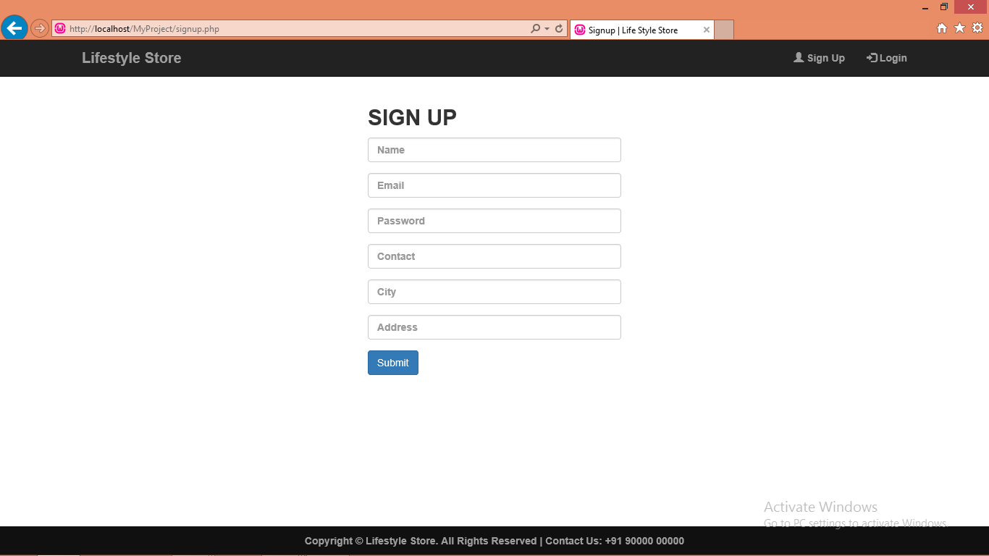
Screenshots
Signup Page

Slide 23
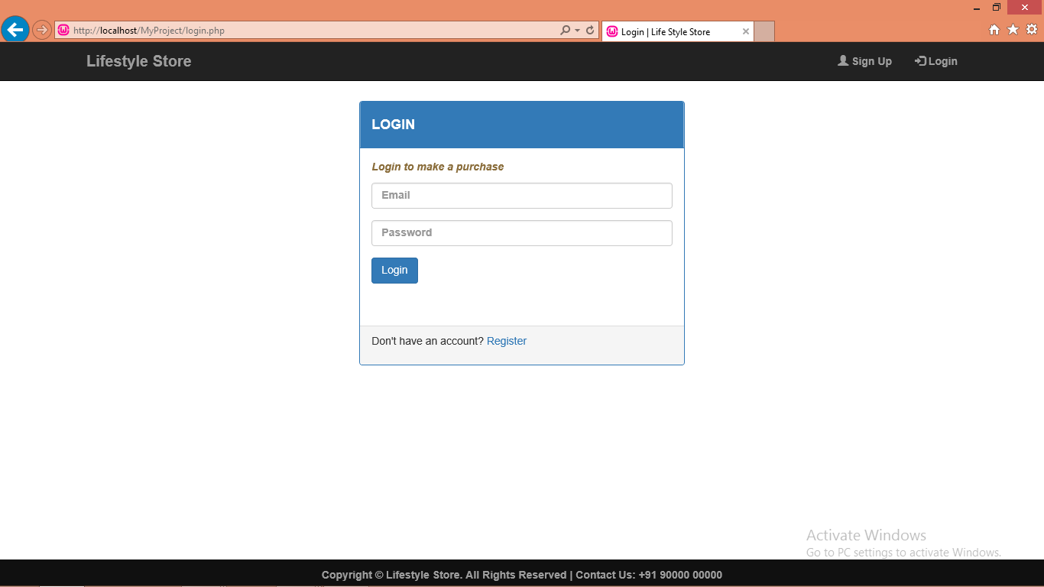
Screenshots
Login Page

Slide 24
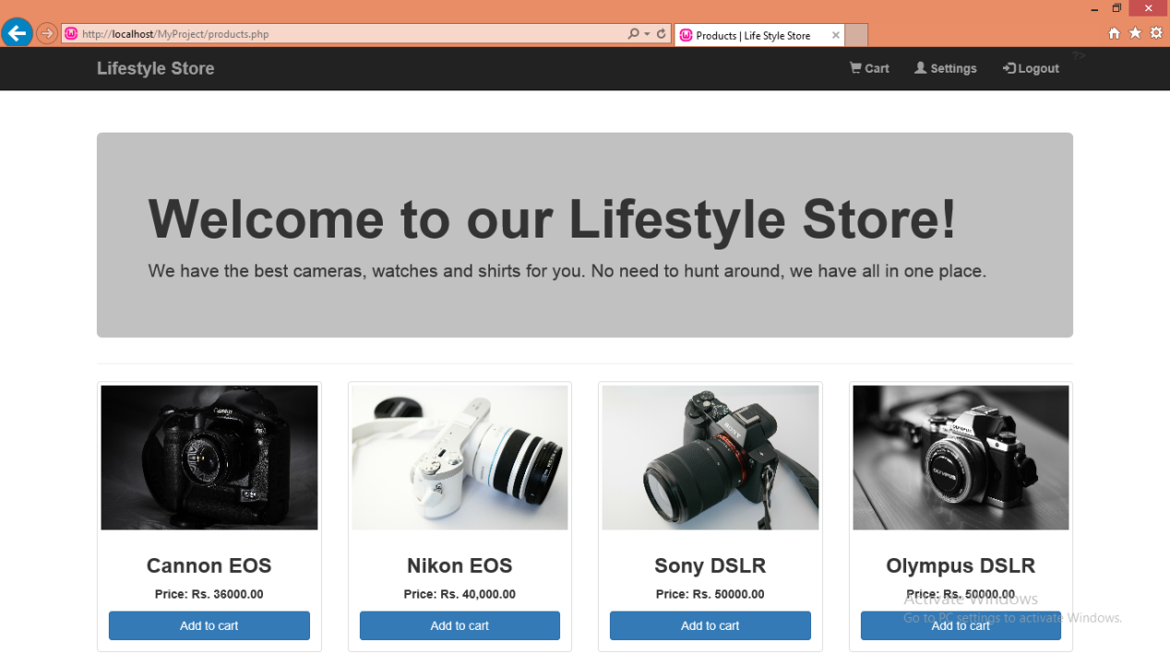
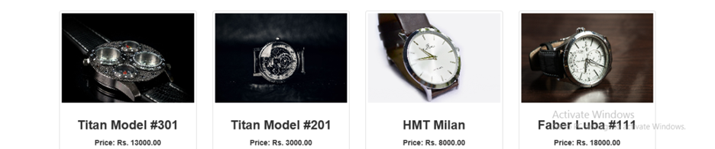
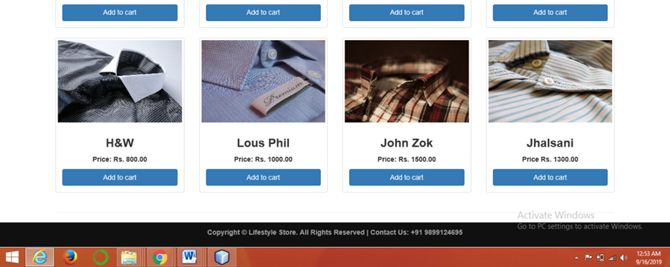
Screenshots
Products Page

Slide 25
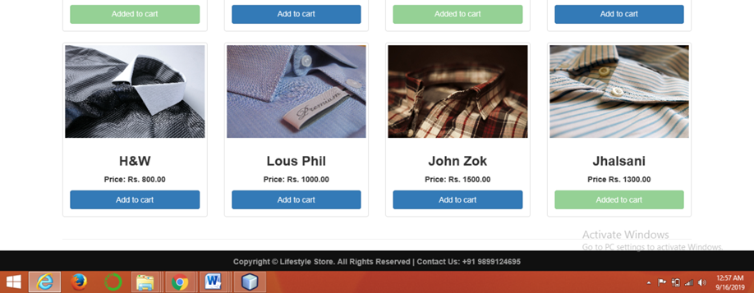
Screenshots
Added to cart Page

Slide 26
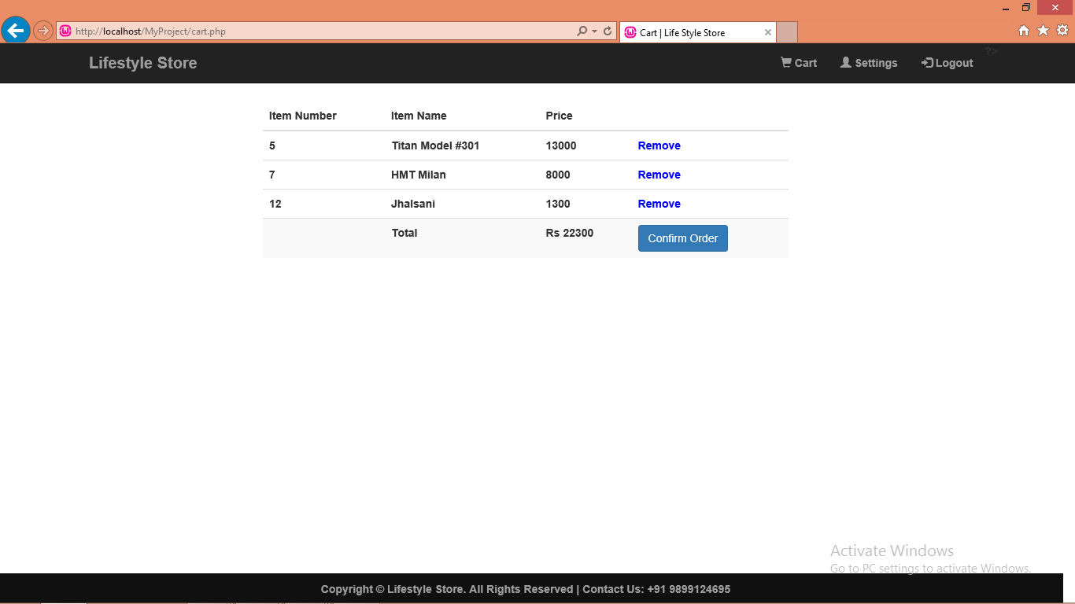
Screenshots
Cart Page

Slide 27
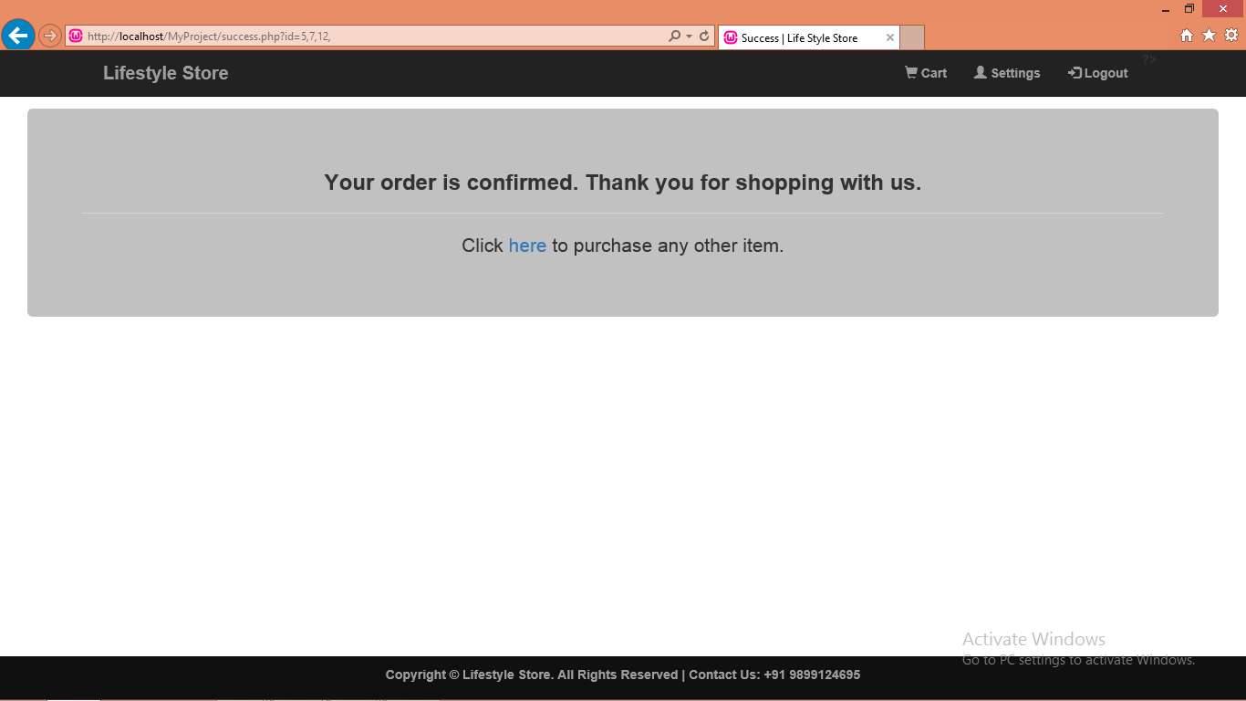
Screenshots
Success page

Slide 28
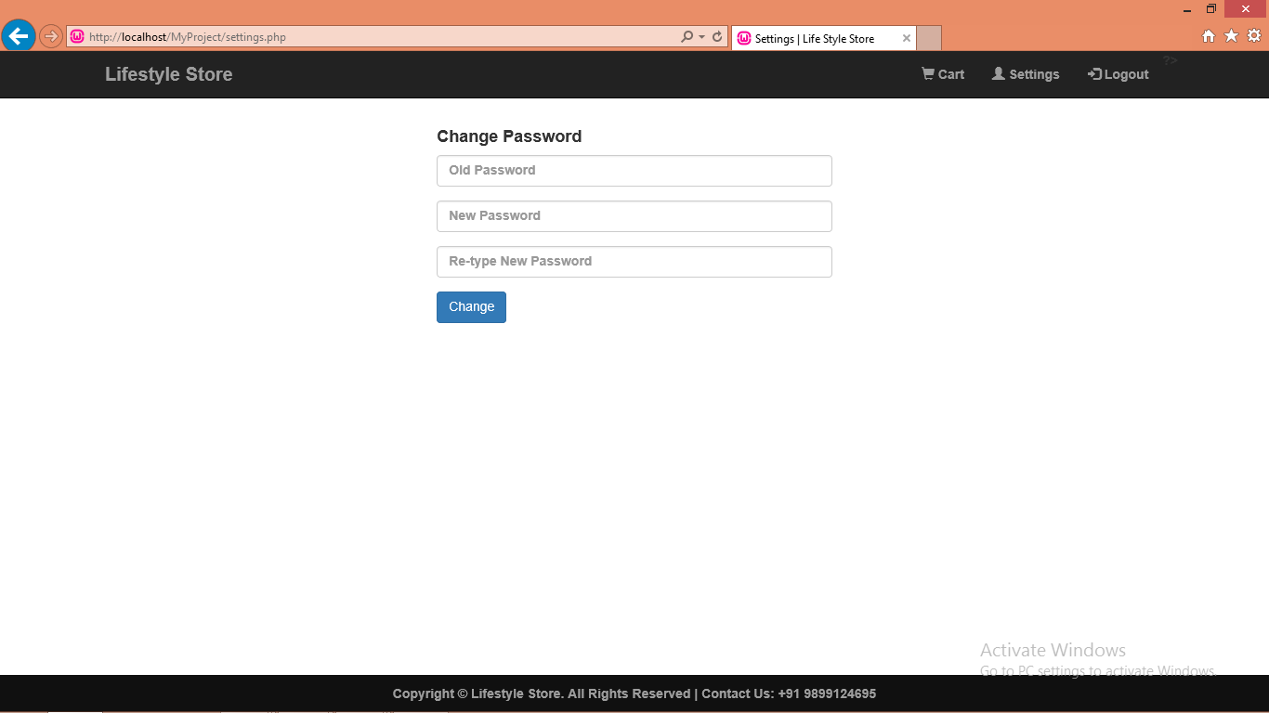
Screenshots
Settings page

Slide 29
References
https://www.tutorialspoint.com
https://www.w3schools.com
https://www.internshala.in
https://www.stackoverflow.com
https://www.geeksforgeeks.org
https://github.com
https://youtube.com
https://google.com

Slide 30
THANK YOU

